Slide 1
Parallel Programming C Review
Pointers

Slide 2
Topics
Pointers and the Address Operator
Pointer Variables
The Relationship Between Arrays and Pointers
Pointer Arithmetic

Slide 3
Pointers and the Address Operator
Each variable in a program is stored at a unique location in memory that has an address
Use the address operator & to get the address of a variable:
int num = -23;
printf(“%d\n”, &num);
// prints address
// in hexadecimal
The address of a memory location is a pointer
Notes:
See pr10-01.cpp

Slide 4
Pointer Variables
Pointer variable (pointer): a variable that holds an address
Pointers provide an alternate way to access memory locations

Slide 5
Pointer Variables
Definition:
int *intptr;
Read as:
“intptr can hold the address of an int” or “the variable that intptr points to has type int”
The spacing in the definition does not matter:
int * intptr;
int* intptr;
* is called the indirection operator

Slide 6
Pointer Variables
Assignment:
int num = 25;
int *intptr;
intptr = &num;
Memory layout:
Can access num using intptr and indirection operator *:
intptr; // prints 0x4a00
*intptr; // prints 25
*intptr = 20; // puts 20 in num
EXAMPLE EXAMPLE 2 EXAMPLE 3
num
intptr
25
0x4a00
address of num: 0x4a00
Notes:
See pr10-02.cpp, pr10-03.cpp and pr10-04.cpp

Slide 7
10.3 The Relationship Between Arrays and Pointers
An array name is the starting address of the array
int vals[] = {4, 7, 11};
printf(“%d\n”,vals); // displays 0x4a00
printf(“%d\n”, vals[0]); // displays 4
4 | 7 | 11
starting address of vals: 0x4a00

Slide 8
The Relationship Between Arrays and Pointers
An array name can be used as a pointer constant
int vals[] = {4, 7, 11};
*vals; // displays 4
A pointer can be used as an array name
int *valptr = vals;
printf(“%d\n”, valptr[1]); // displays 7
Notes:
See pr10-05.cpp, pr10-06.cpp, pr10-07.cpp, and pr10-08.cpp

Slide 9
Pointers in Expressions
Given:
int vals[]={4,7,11};
int *valptr = vals;
What is valptr + 1?
It means (address in valptr) + (1 * size of an int)
printf(“%d \n”, *(valptr+1)); // displays 7
printf(“%d \n”, *(valptr+2)); // displays 11
Must use ( ) in expression

Slide 10
Array Access
Array elements can be accessed in many ways
Array access method | Example
array name and [ ] | vals[2] = 17;
pointer to array and [ ] | valptr[2] = 17;
array name and subscript arithmetic | *(vals+2) = 17;
pointer to array and subscript arithmetic | *(valptr+2) = 17;

Slide 11
Array Access
Array[index] is equivalent to *(Array + index)
Warning: It is possible to give the pointer an address outside the array

Slide 12
Array Access
Array notation
vals[i]
is equivalent to the pointer notation
*(vals + i)
No bounds checking is performed on array access
EXAMPLE

Slide 13
Array Access
double readings[20], totals[20];
double *ptr;
LEGAL
dptr = readings; // equivalent → dptr = &readings[0]
dptr = totals;
NOT LEGAL
readings = totals;
totals = dptr;

Slide 14
Pointer Arithmetic
Some arithmetic operators can be used with pointers:
Increment and decrement operators ++, --
Integers can be added to or subtracted from pointers using the operators +, -, +=, and -=
One pointer can be subtracted from another by using the subtraction operator –
NOT ALLOWED → All others example multiplication and div

Slide 15
Pointer Arithmetic
Assume the variable definitions
int vals[]={4,7,11};
int *valptr = vals;
Examples of use of ++ and --
valptr++; // points at 7
valptr--; // now points at 4
Notes:
See pr10-09.cpp

Slide 16
More on Pointer Arithmetic
Assume the variable definitions:
int vals[]={4,7,11};
int *valptr = vals;
Example of the use of + to add an int to a pointer:
printf(“%d\n”,*(valptr + 2))
This statement will print 11

Slide 17
More on Pointer Arithmetic
Assume the variable definitions:
int vals[]={4,7,11};
int *valptr = vals;
Example of use of +=:
valptr = vals; // points at 4
valptr += 2; // points at 11

Slide 18
More on Pointer Arithmetic
Assume the variable definitions
int vals[] = {4,7,11};
int *valptr = vals;
Example of pointer subtraction
valptr += 2;
cout << valptr - vals;
This statement prints 2: the number of
ints between valptr and vals
EXAMPLE EXAMPLE

Slide 19
Initializing Pointers
Can initialize to NULL or 0 (zero)
int *ptr = NULL;
----------------------------------
Can initialize to addresses of other variables
int num, *numPtr = &num;
int val[ISIZE], *valptr = val;
----------------------------------
Initial value must have correct type
float cost;
int *ptr = &cost; // won't work, DIFFERENT TYPE

Slide 20
Comparing Pointers
Relational operators can be used to compare addresses in pointers
Comparing addresses in pointers is not the same as comparing contents pointed at by pointers:
if (ptr1 == ptr2) // compares
// addresses
if (*ptr1 == *ptr2) // compares
// contents
Notes:
See pr10-10.cpp

Slide 21
Pointers as Function Parameters
A pointer can be a parameter
It works like a reference parameter to allow changes to argument from within a function
A pointer parameter must be explicitly dereferenced to access the contents at that address

Slide 22
Pointers as Function Parameters
Requires:
1) asterisk * on parameter in prototype and
heading
void getNum(int *ptr);
2) asterisk * in body to dereference the pointer
*ptr;
3) address as argument to the function in the call
getNum(&num);
Notes:
See pr10-11.cpp

Slide 23
Pointers as Function Parameters
Analogy
Use this as a point of reference for common sense
int var = 10;
int* ptr = &var
(where it will be stored) (what will be sent)
----------------------------------------
void getNumber(int *)
doubleValue(&number)
void getNumber(int *input) { BODY HERE }
Notes:
See pr10-11.cpp

Slide 24
Pointers as Function Parameters
void swap(int *x, int *y)
{
int temp;
temp = *x;
*x = *y;
*y = temp;
}
int num1 = 2, num2 = -3;
swap(&num1, &num2); //call
Notes:
See pr10-12.cpp

Slide 25
Pointers to Constants and Constant Pointers
Pointer to a constant: cannot change the value that is pointed at
Constant pointer: the address in the pointer cannot change after the pointer is initialized

Slide 26
Ponters to Constant
Must use const keyword in pointer definition:
const double taxRates[] =
{0.65, 0.8, 0.75};
const double *ratePtr;
Use const keyword for pointers in function headers to protect data from modification from within function

Slide 27
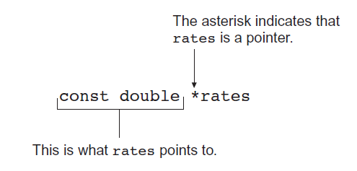
Pointer to Constant – What does the Definition Mean?
Read as: “rates is a pointer to a constant that is a double.”
Notes:
See pr10-13.cpp

Slide 28
Constant Pointers
Defined with const keyword adjacent to variable name:
int classSize = 24;
int * const classPtr = &classSize;
Must be initialized when defined
Can be used without initialization as a function parameter
Initialized by argument when function is called
Function can receive different arguments on different calls
While the address in the pointer cannot change, the data at that address may be changed

Slide 29
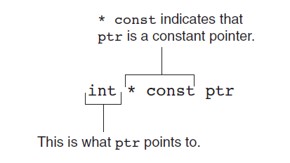
Constant Pointer – What does the Definition Mean?
Read as: “pts is a constant pointer to an int.”

Slide 30
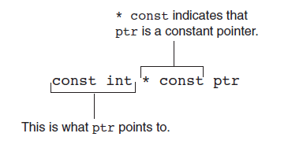
Constant Pointer to Constant
Can combine pointer to constants and constant pointers:
int size = 10;
const int * const ptr = &size;
What does it mean?

Slide 31
Returning Pointers from Functions
Pointer can be return type of function
int* newNum();
The function must not return a pointer to a local variable in the function
The function should only return a pointer
to data that was passed to the function as an argument
to dynamically allocated memory
Notes:
See pr10-15.cpp

Slide 32
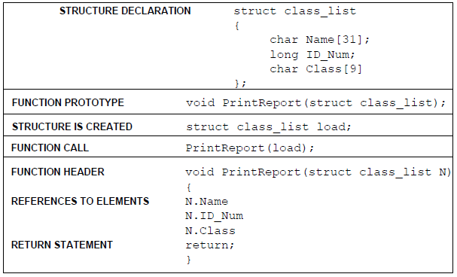
Passing a Structure to a FX

Slide 33
Structure Pointer Operator
Simpler notation than (*ptr).member
Use the form ptr->member:
stuPtr->studentID = 12204;
squarePtr->setSide(14);
in place of the form (*ptr).member:
(*stuPtr).studentID = 12204;
(*squarePtr).setSide(14);

Slide 34
Selecting Members
Situation: A structure contains a pointer as a member. There is also a pointer to the structure.
Problem: How do we access the pointer member via the structure pointer?
struct GradeList
{ string courseNum;
int * grades;
}
GradeList test1, *testPtr = &test1;

Slide 35
Structure Pointers as Function Parameters
Pointers to structures passed as parameters to functions
Such pointers provide a pass-by-reference parameter mechanism
Pointers must be dereferenced in the function to access the member fields
Notes:
See pr10-17.cpp

Slide 36
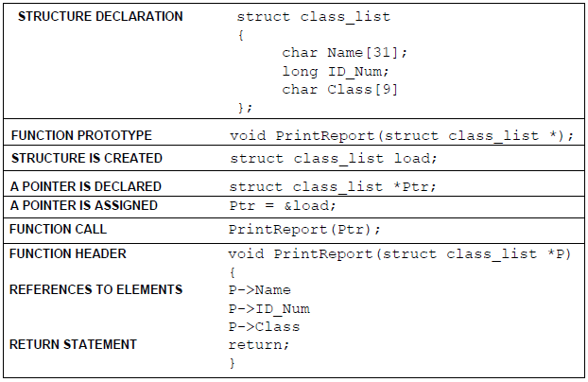
A Fx that receives a pointer to a structure

Slide 37
Selecting Members
Expression | Meaning
testPtr->grades | Access the grades pointer in test1. This is the same as (*testPtr).grades
*testPtr->grades | Access the value pointed at by testPtr->grades. This is the same as *(*testPtr).grades
*test1.grades | Access the value pointed at by test1.grades

Slide 38
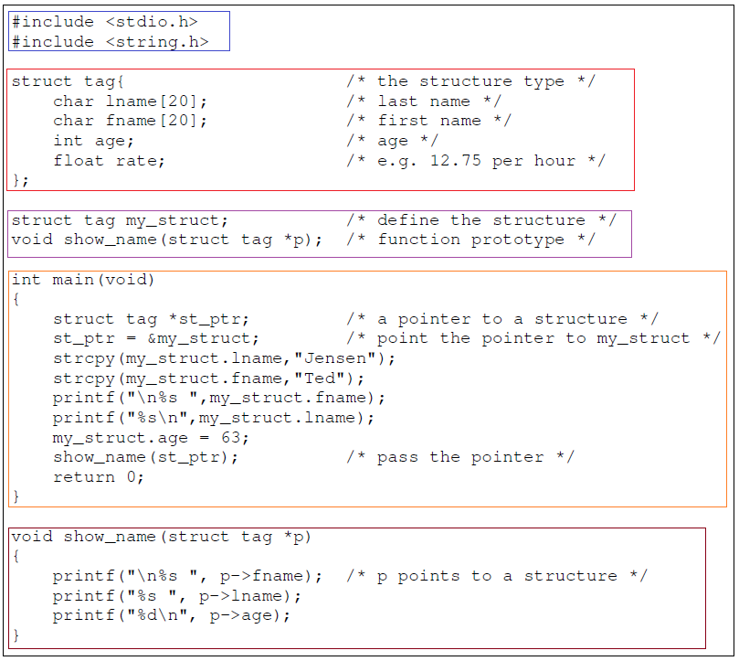

Slide 39
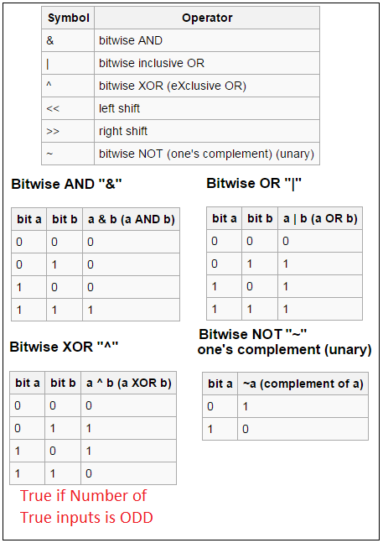
Bitwise Operations

Slide 40
Bitwise Operations
Do you remember me ?
void swap(int *x, int *y)
{
int temp;
temp = *x;
*x = *y;
*y = temp;
}
int num1 = 2, num2 = -3;
swap(&num1, &num2); //call

Slide 41

The Beautiful and uncomprehended XOR
(For simplicity we will assume INT to have four bits)
int x=4 (#b 1000)
int y= 1; (#b 0001)
x = x ^ y ; (#b 1001)
y = x ^ y ; (#b 1000)
x = x ^ y ; (#b 0001)
We do not need a function
No pointer needed
No temp variable needed
4. yeap, I know

Slide 42
Bit shift Operators
They will take two arguments
x and n
Distributed as follows
x << n (Shift to the Left = x*(2^n)) [Multiplication]
x >> n (Shift to the Right= x/(2^n))[Division]

Slide 43
#include <stdio.h>
int main() {
int x=2; int n=4;
printf("x<<n = 2<<4 =%d\n",x<<4);
printf("x= %d\n", x);
return 0;
}
Output:
x<<n = 2<<4 =32
x= 2
Careful, The original INFO remain UNCHANGED

Slide 44
Students:
Reading Assignment: Please Review Memory Allocation in C (NOT C++)

